Slide 1

Mood2read: A Virtual Assistant for Book Recommendation
Built with IBM Watson Assistant
Mentor: R Devnath Sir
Presented by: Nandani Prakash

Slide 2
Objective:
To build a Virtual Assistant that recommends books based on:
User mood(e.g., happy, sad, tired, angry, relaxed)
Genre(e.g., romance, thriller, fantasy, horror, comedy)
Author(e.g., Colleen Hoover, J.K. Rowling, Matt Haig, etc.)
To Create a Personalized and Engaging User Experience: Make the process of finding the right book more interactive, personalized, and efficient.
To Utilize IBM Watson’s Natural Language Understanding: Use intents, entities, and dialog in Watson Assistant to understand user inputs and provide meaningful replies.

Slide 3
Why we need this?
Personalized Conversations: The assistant can ask questions like: "What mood are you in?“ Do you prefer romance or thriller today?“ Based on user input (mood, genre, favorite authors), it gives tailored book suggestions.
Natural Language Understanding (NLU): IBM Watson Assistant can understand natural language, making the interaction feel human. For example: “I want a light romantic comedy for a weekend read” → Watson understands this intent and mood.
24/7 Availability: A virtual assistant is always available to help users anytime—no need to wait for a librarian or app support.
Interactive User Experience :Instead of a static website with book lists, users can chat with the bot, ask questions, get summaries, reviews, etc.

Slide 4
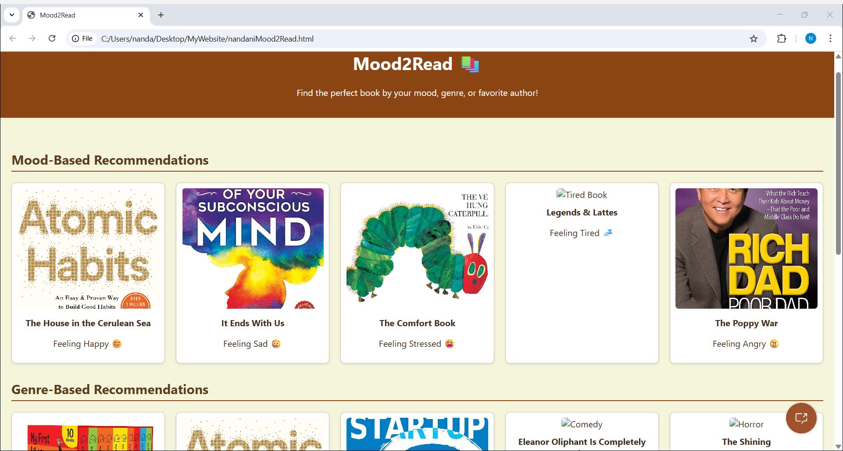
Introducing Mood2Read – A AI Book Recommender
Created a website and embedded a virtual assistant

Slide 5
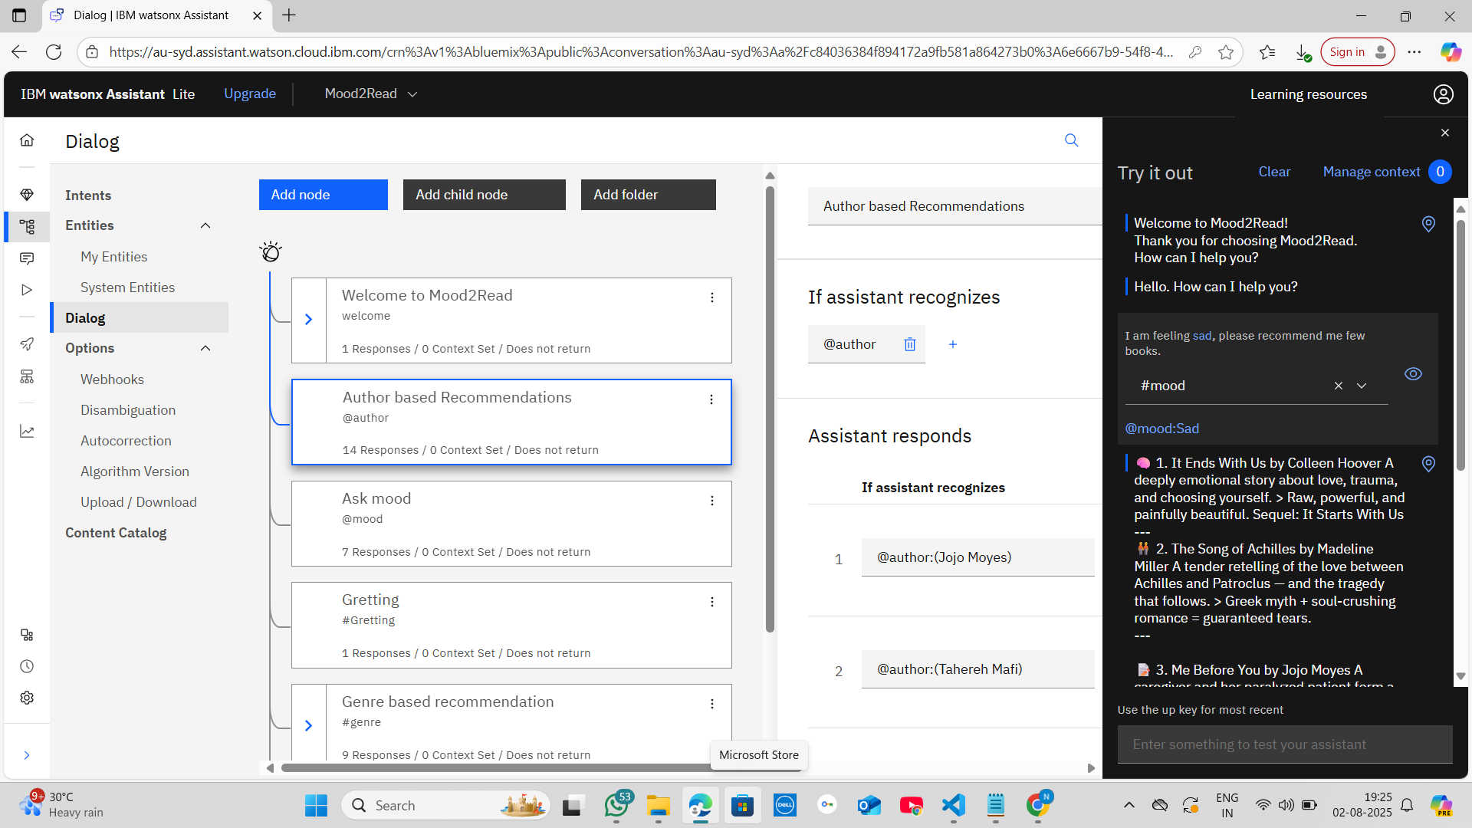
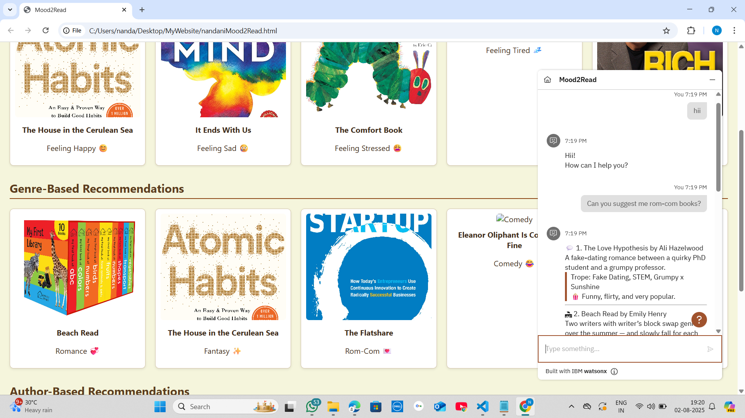
Conversation Virtual Assistant with its Features In these photos we can see the features . It provide us book recommendation on the basis of genre, author and the user’s mood. It feels like you are talking with a person who loves reading books and suggests you .

Slide 6
Tools & Technologies Used
IBM Watson Assistant: To build the intelligent chatbot that understands and replies based on user inputs (mood, genre, author)
HTML + CSS: To design the user interface (UI) for the chatbot (if you created a website)
JavaScript: To handle chatbot behavior and communication with Watson API on the frontend
VS Code: Code editor and development environment
GitHub: Version control and project hosting
“When life feels too much – read instead”

Slide 7
THANK YOU

